Slide 1
Paper Title : Design And Implementation Of An IoT-Based
Smart Emergency Alert System
Authors Details
Dr. Madhuri .P. Borawake,
Ms. Sharvari Chambhare,
Ms. Neha Shinge,
Ms. Sai Deshmukh,
Student - UG ,
PDEA’s College of Engineering,
Pune , Maharashtra
Paper Id : 2604070
Presenter Category : UG
Presented by
Ms. Sharvari Chambhare,
Student - UG ,
PDEA’s College of Engineering,
Pune, Maharashtra

Slide 2
PRESENTATION FRAMEWORK
Abstract
Introduction
Problem Statement and Proposed Solution
Literature Review
Methodology
SDLC Model
Experiments and Analysis
Results & Discussion
Conclusion

Slide 3
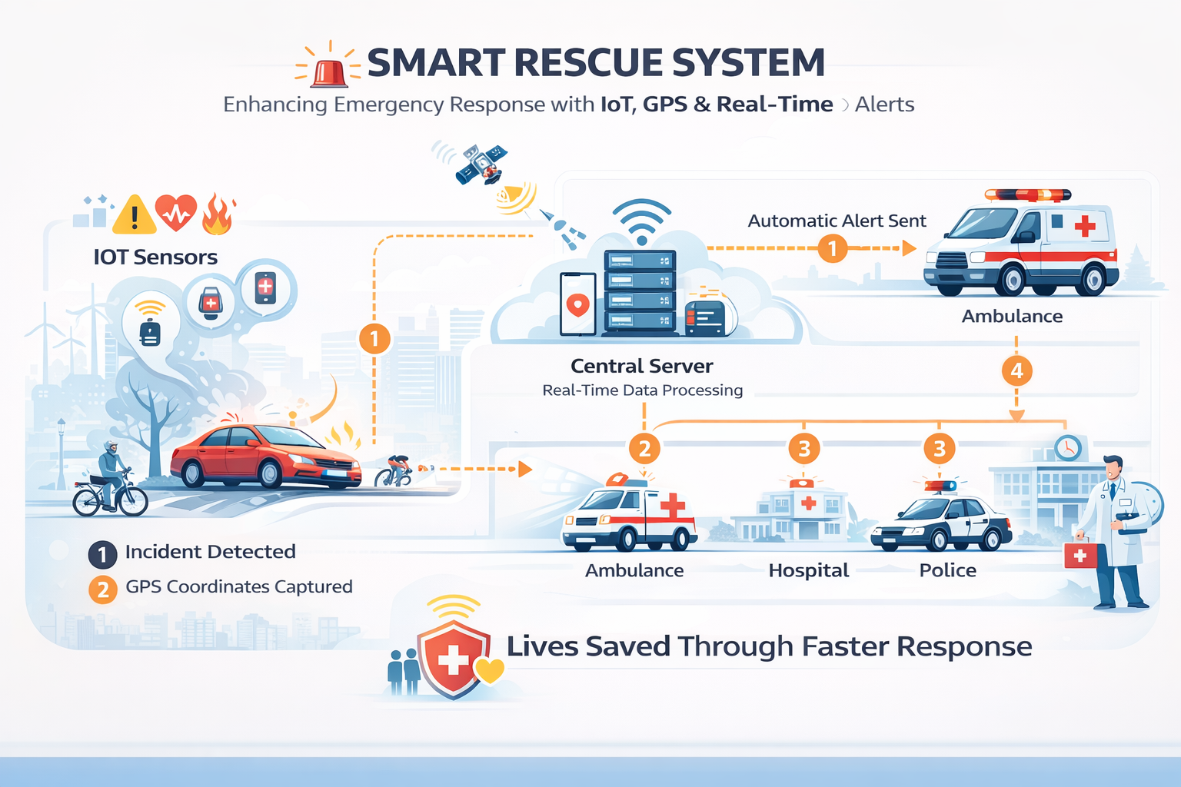
ABSTRACT
The Smart Rescue System is designed to improve emergency response in accidents, medical emergencies, and disasters
Traditional systems face delays due to manual reporting and lack of real-time coordination
The system uses IoT, GPS, and real-time communication for automatic detection
Sends instant alerts to hospitals and emergency response units
Provides accurate location tracking and faster communication
Reduces response time, minimizes human intervention, and helps save lives

Slide 4
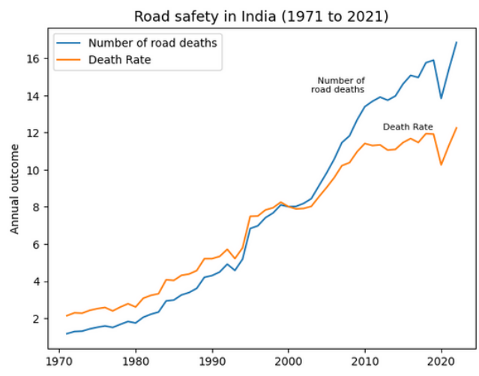
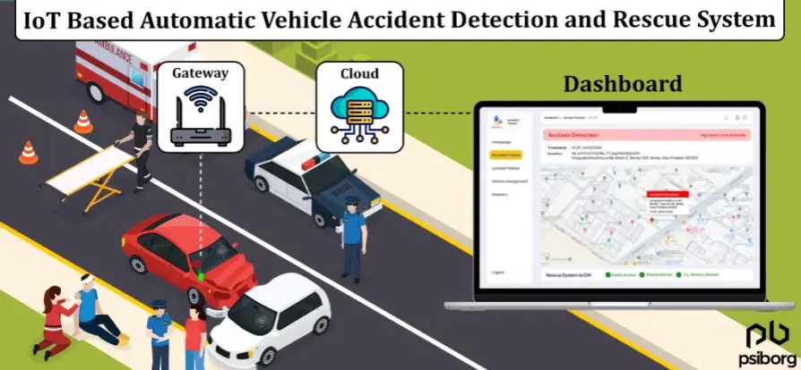
Introduction
Emergency situations such as road accidents, medical crises, and fire hazards are increasing
Many lives are lost due to:
• Delayed emergency response
• Lack of real-time information
• Poor coordination between services
This is evident in real-life scenarios:
🚗 Accidents → delayed help
🏥 Medical emergencies → ambulance delays
🔥 Fire incidents → slow response
These challenges highlight the need for a smart and automated rescue system

Slide 5
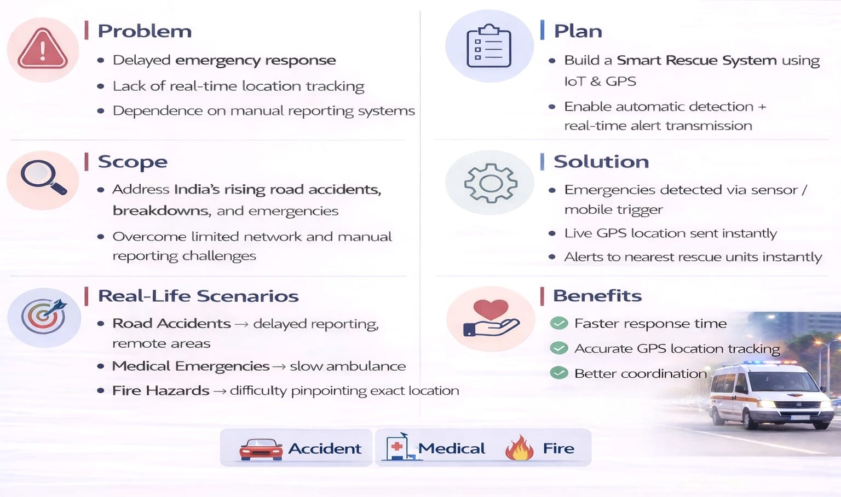
Problem Overview & Proposed Solution

Slide 6
Literature Review
Ref | Paper Name | Author (Year) | Key Idea | Advantages
[1] | IoT-Based Smart Accident Detection and Early Warning System | C. V. Suresh Babu & Maclin Vinola (2024) | IoT + Deep Learning detection | High accuracy, early warning
[2] | IoT Based Smart Emergency Response System (SERS) | Abu S. M. Mohsin & Muyeed (2024) | Multi-sensor + Cloud system | Scalable, efficient response
[3] | AI Enabled Accident Detection and Alert System Using IoT and Deep Learning | P. Vetal (2023) | IoT + GPS accident detection | Accurate alerts, automation
[4] | Accident Detection and Alerting Systems: A Study | Muhammad Ahmad Baballe (2022) | Comparative IoT study | Identifies best technologies
[5] | IoT Based Car Accident Detection and Notification Algorithm | Shivani Sharma (2021) | Automated alert system | Faster response time

Slide 7
Literature Review
Gap Analysis & Limitations Identified in Existing Research
High system complexity and implementation cost
Dependence on large datasets and computational resources
Data privacy and security concerns
GPS and network limitations in remote areas
Existing systems lack cost efficiency and real-time integrated response.

Slide 8
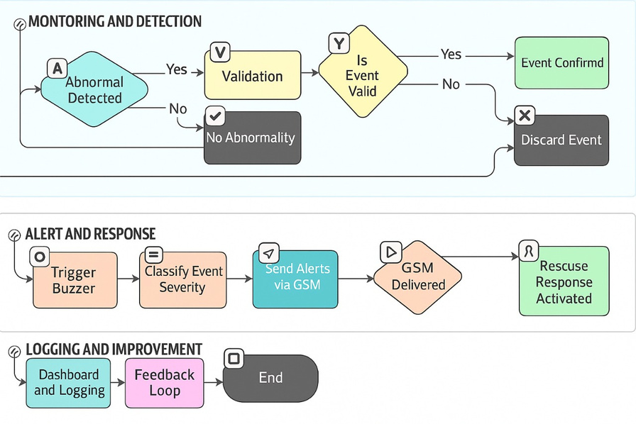
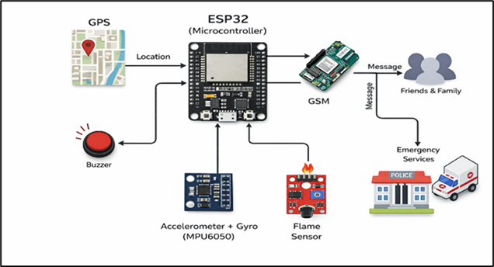
Methodology
System Architecture
Sensors continuously monitor vehicle condition
Abnormal impact is detected using threshold logic
ESP32 processes data and confirms accident
GPS module fetches real-time location
GSM sends alert to emergency response units
System Workflow

Slide 9
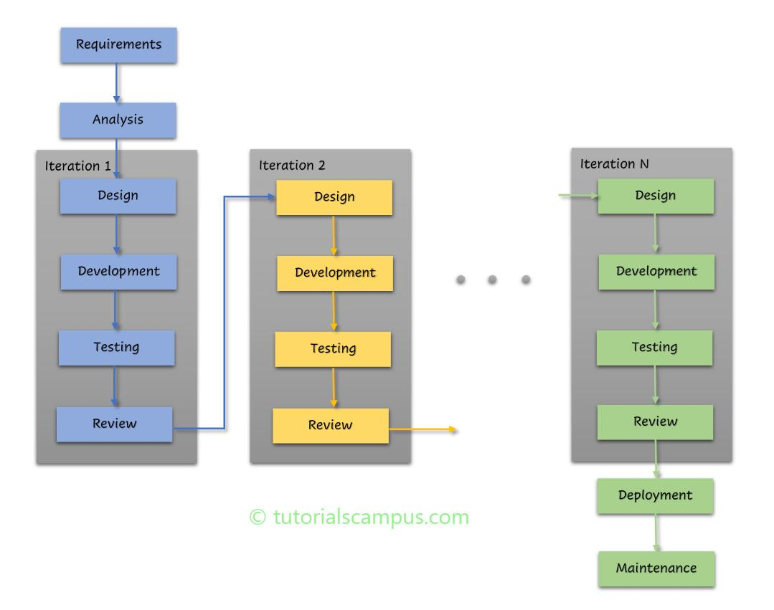
SDLC Model
ITERATIVE MODEL
Requirement Analysis
Design & Implementation
Testing
Deployment
Iteration

Slide 10
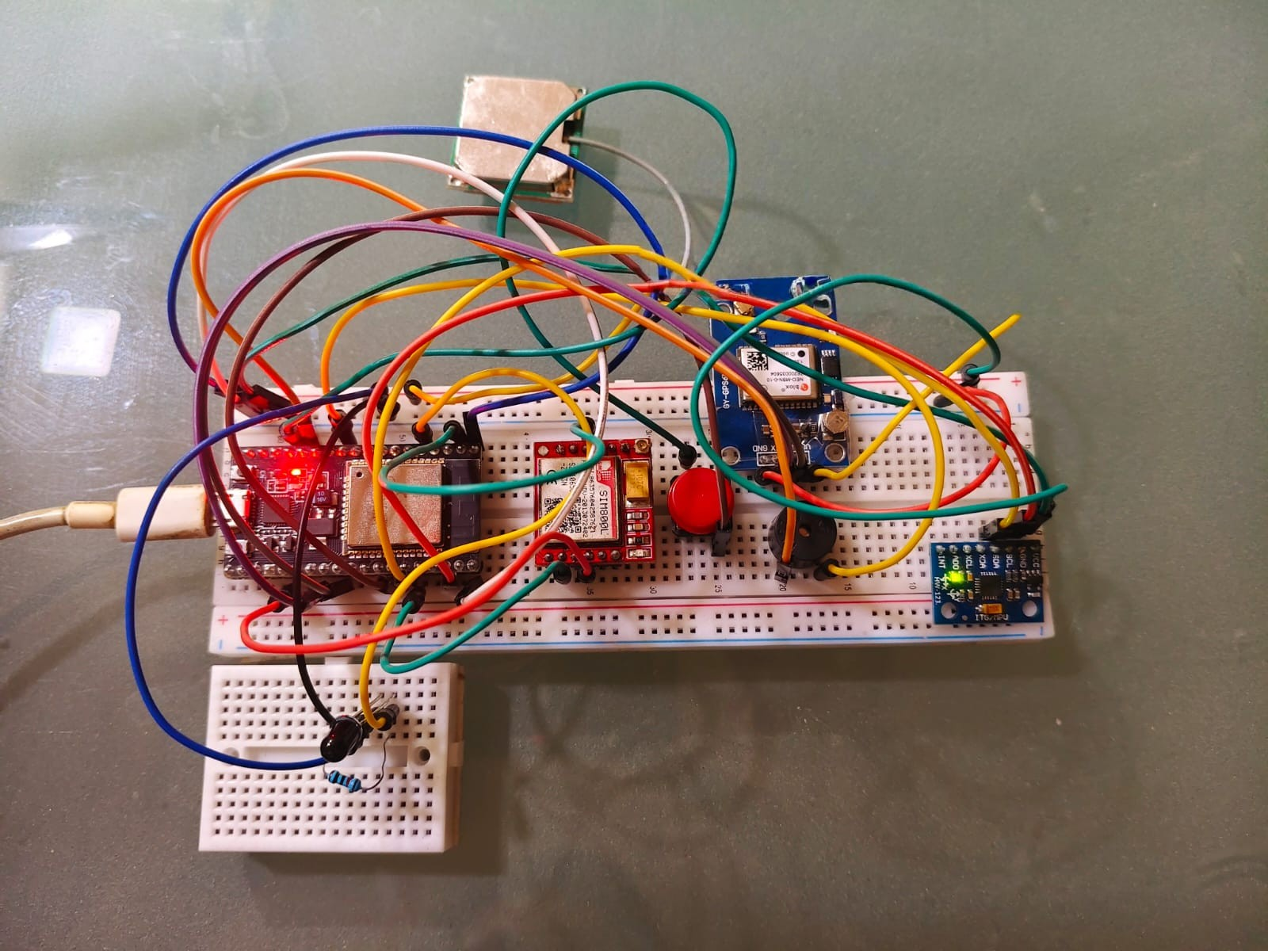
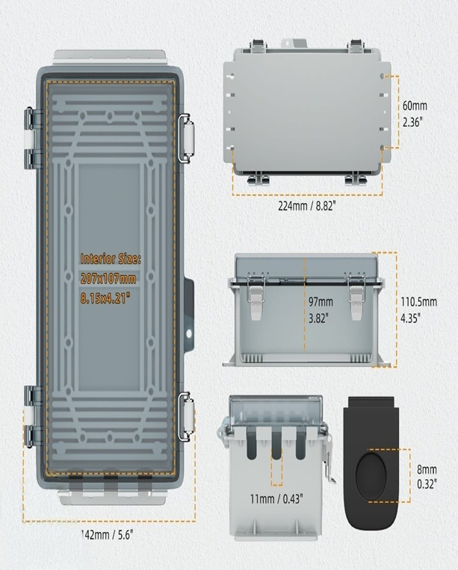
EXPERIMENTAL SETUP AND ANALYSIS
Experimental Setup
Implemented system using ESP32, sensors, GPS, and GSM modules
Tested under simulated conditions for accident and fire detection
Test Scenarios
🚗 Accident detection using MPU6050 accelerometer
🔥 Fire detection using flame sensor
📍 GPS location retrieval using gps Neo M8N module
📡 GSM alert transmission using gsm sim 800L module
Performance Parameters
Response time (detection + alert)
Detection accuracy
GPS accuracy
Alert success rate

Slide 11
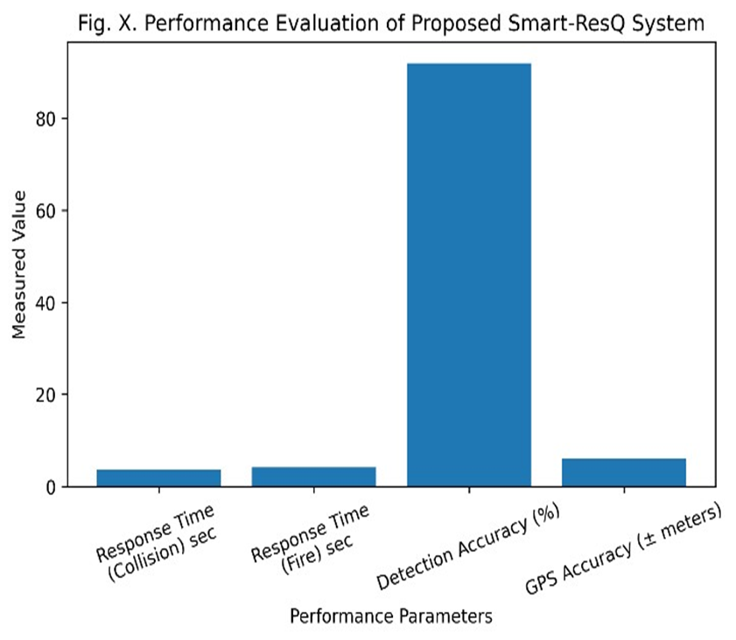
Result & Discussion
Latency Reduction
Response time reduced to 2–10 seconds
Reliability & Accuracy
Achieves 95–97% detection and location accuracy
Multi-Scenario Capability
Handles: Accidents , Medical emergencies , Fire hazards
System Efficiency
Low power consumption and secure data transmission

Slide 12
Conclusion
Conclusion
The proposed SmartResQ system addresses key challenges in emergency response
Provides a smart and automated solution, reducing dependence on manual reporting
Enables faster coordination with emergency response units
Demonstrates strong potential for improving road safety and emergency management
Suitable for real-world deployment and scalable applications
Future Improvements:
Notification system for Sensor failure scenario.
Mobile app integration
Integrate cloud System for Contact database.

